Slide 1
Service Desk
Chris Hendon

Slide 2
Goals and KPIs
KPIs
percentage of tickets closed without escalation to second or third line support
average cost of handling specific request types
average time to escalate a ticket
SMART goals for the job like: being able to complete and close tickets 95% of the time, Having a 24 hour response time to tickets.

Slide 3
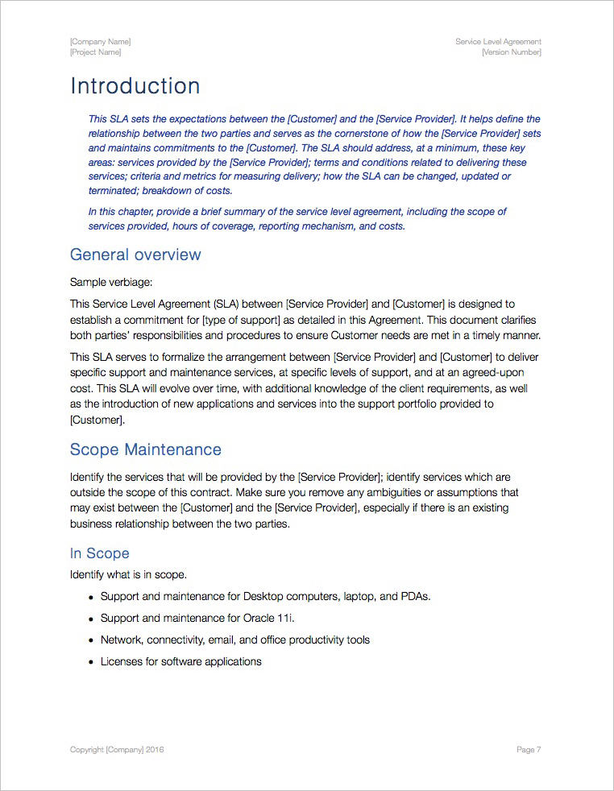
Service Level Agreement

Slide 4
Satisfaction Survey
 | Very Satisfied | Satisfied | Neutral | Dissatisfied | Very Dissatisfied
The Service Desk had the ability to solve your issues
The issue was handled in a courteous manner
The issue was handled quickly and efficiently
Overall satisfaction

Slide 5
